Slide 1
Predicting Obesity using Eating and Health Habits
By: Christian Burns, Redmond Xia, Jiayu Zhang

Slide 2
Data Source
2014-2016 Eating & Health Module Data sponsored by the U.S. Department of Agriculture’s Economic Research Service

Slide 3
Goals:
Classify whether a respondent is obese or not from survey responses
Predict BMI from responses

Slide 4
Data Analysis

Slide 5
Data Cleaning
36 predictors -> 11
Income level,
Time spent eating meals & eating outside of meals
Type of soda drank
Exercise frequency
Fast food frequency
Level of food in household
Snap/WIC benefits received
Meat in diet
10210 observations -> 9698 -> 325

Slide 6
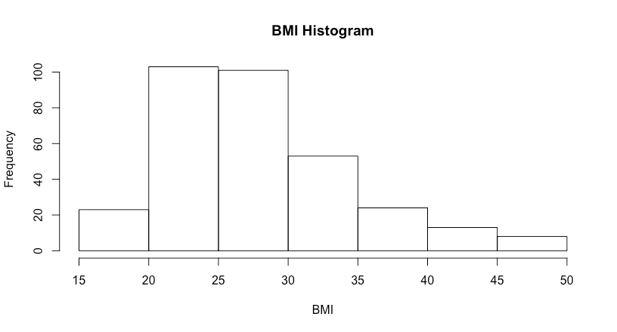
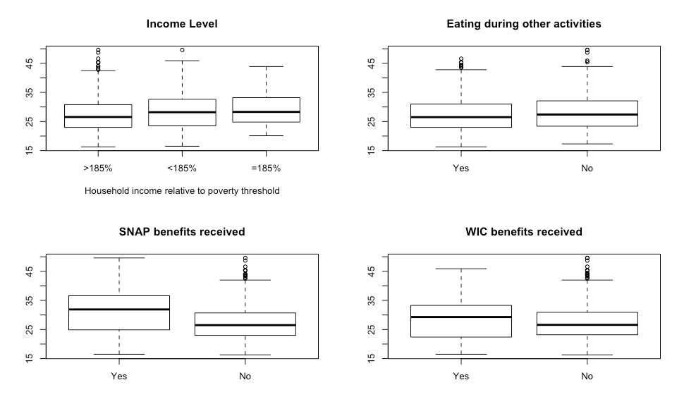
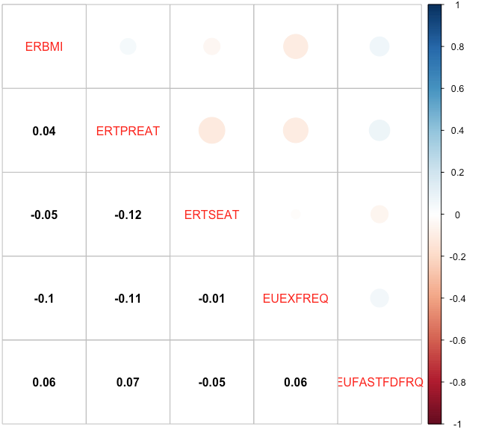
Visualization
BMI Distribution
Predictor Covariance
BMI by responses to categorical variables

Slide 7
Regression

Slide 8
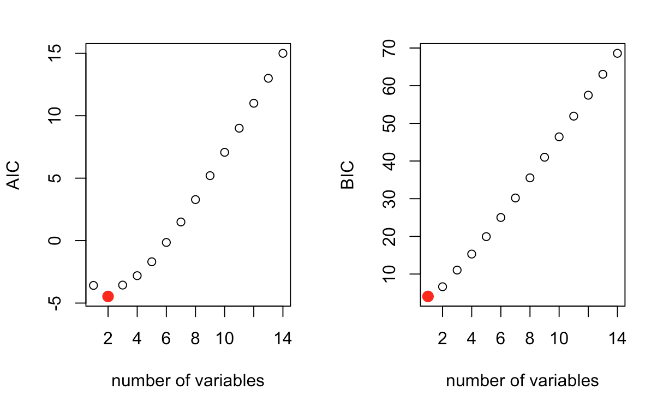
Best Subset Selection
AIC
Eating or drinking during other activities, SNAP benefits
BIC
SNAP benefits

Slide 9
Shrinkage Methods
Lasso & Ridge
Both found the most important variables to be eating or drinking during other activities and whether or not the respondent received SNAP benefits.
Ridge reduced other variables to small values.
Lasso reduced other variables to zero.

Slide 10
Comparison of Methods
 | AIC | BIC | Ridge | Lasso
Test error | 24.16274 | 22.93261 | 22.80036 | 22.90809

Slide 11
Classification

Slide 12
Results
Split BMI into two groups: BMI>30 and BMI<30
 | Logistic | 7-KNN | LDA | QDA | Pruned Single Tree | Random Forest | SVM | Radial SVM
Test error in % | 23.08 | 18.46 | 23.08 | 29.23 | 23.00 | 21.5 | 23.00 | 26.00

Slide 13
Implications

Slide 14
Limitations
Prevalence of Categorical Variables
Only a small subset of data was used
Removed >96% of observations
Current health habits may not be reflective of BMI
Ex: Obese person trying to lose weight

Slide 15
Conclusion
Among all regression methods, ridge shrinkage works best for prediction of BMI value given the variables we chose; Among all classification methods, KNN performs a better result in classify whether the individual shall be obese or not.
Eating or drinking while doing other things at the same time is suggested to be a bad habit in prevention of obesity .
Family income may play a role in prediction of obesity since people not receiving benefits from SNAP are less likely to be obese.

